Slide 1
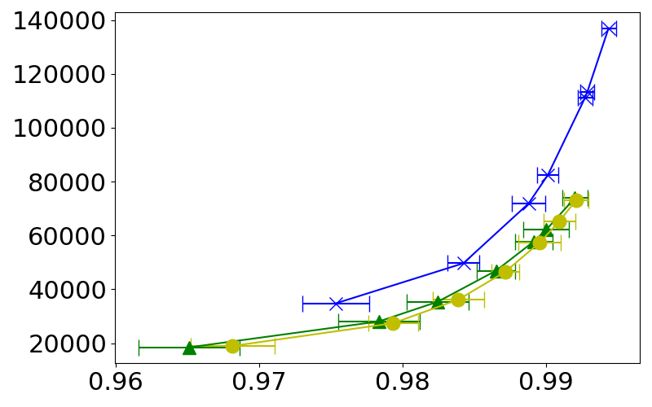
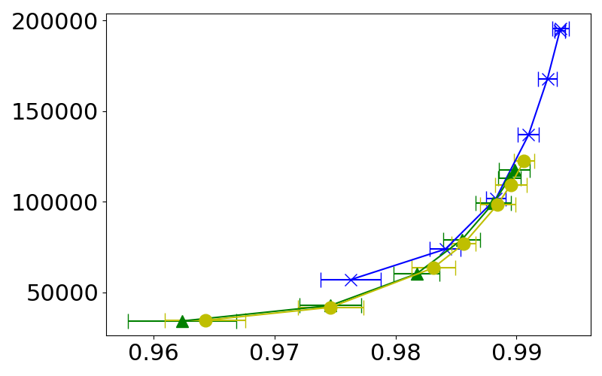
Evolution time = 0.15
8 qubit
10 qubit
~30% reduction
~10% reduction

